Slide 1
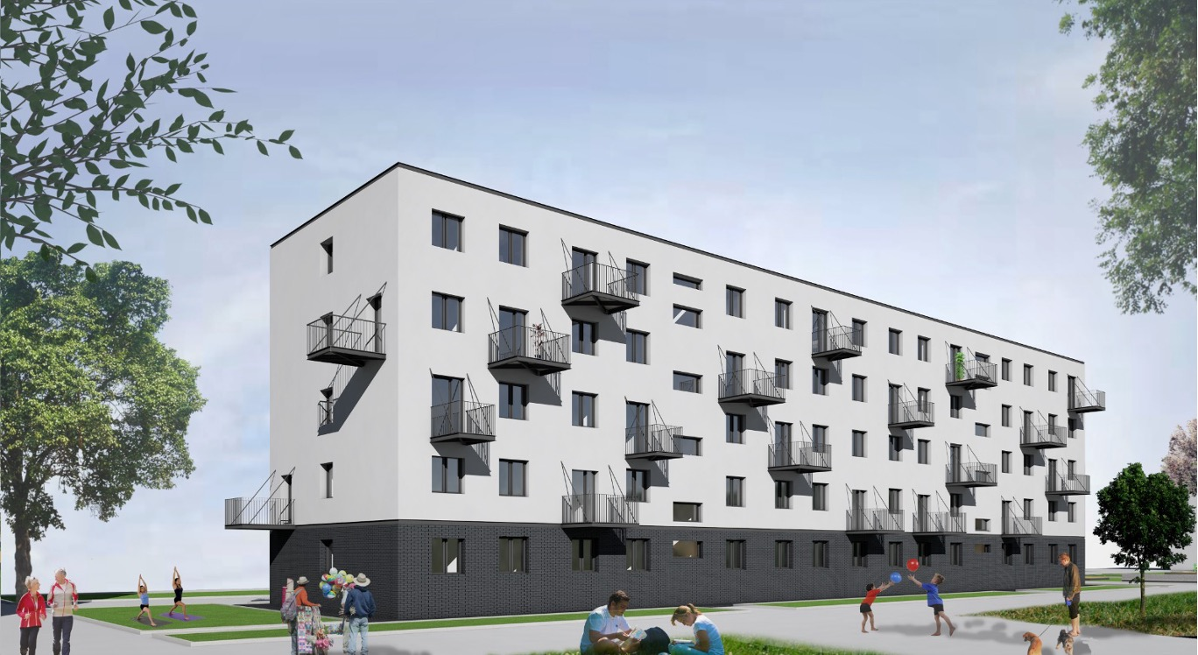

Housing As An Entry Point for Roma Inclusion
Presented By: Dyfed Aubrey – Chief Officer UN-Habitat Brussels

Slide 2
Table of Contents
Contextualizing the Roma exclusion
UN-Habitat’s Approach to Housing
Case Study
An Inclusive Settlements Approach
Technical/Financial Instruments
The Roma Housing Platform

Slide 3
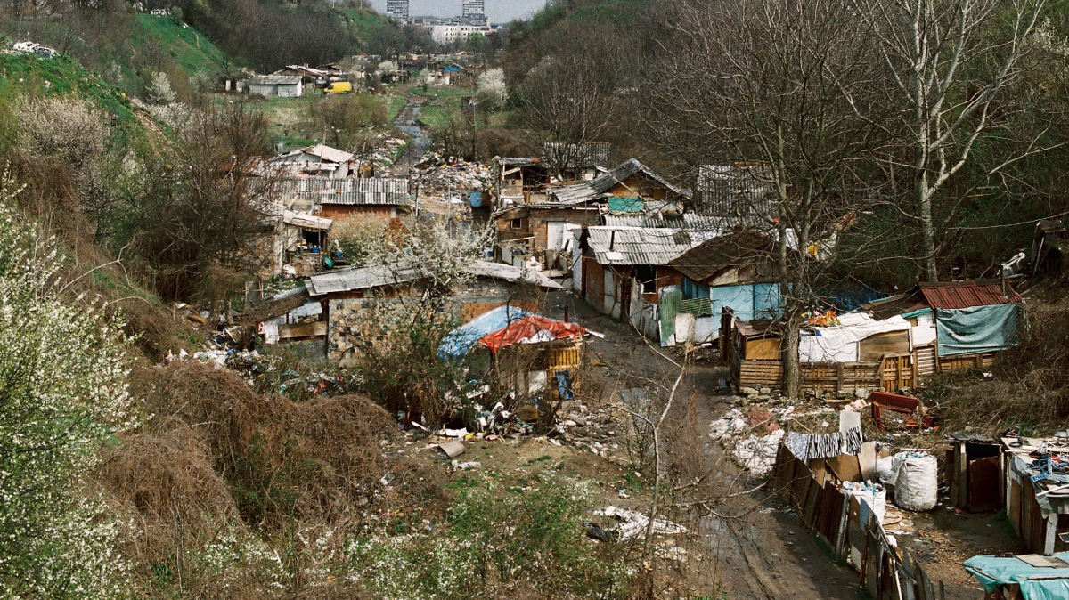
Context
The Roma/Traveler’s Experience

Slide 4
Roma Housing Conditions – Key Data (FRA)
80%+ of Roma are at risk of poverty
1 in 5 Roma households lack access to running water
Roma employment rate is around 43%, compared to ~70% in the general population
25% of Roma have faced housing discrimination in the last 5 years
33% do not have an indoor toilet
Over 80% live in overcrowded households

Slide 5
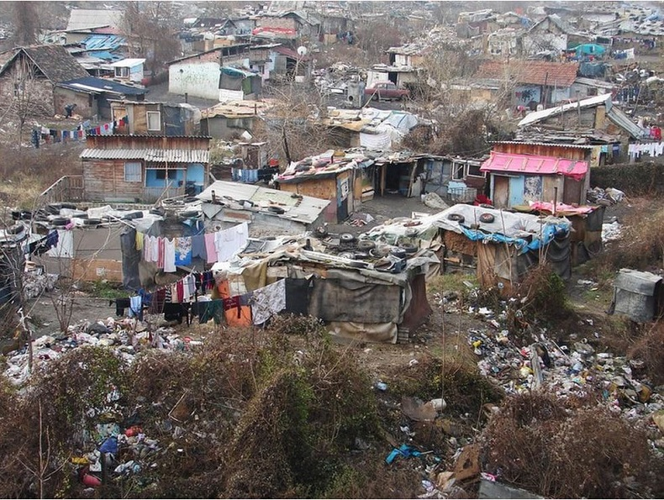
Numbers Can Get Abstract
But visuals paint a clear picture of deprivation

Slide 6
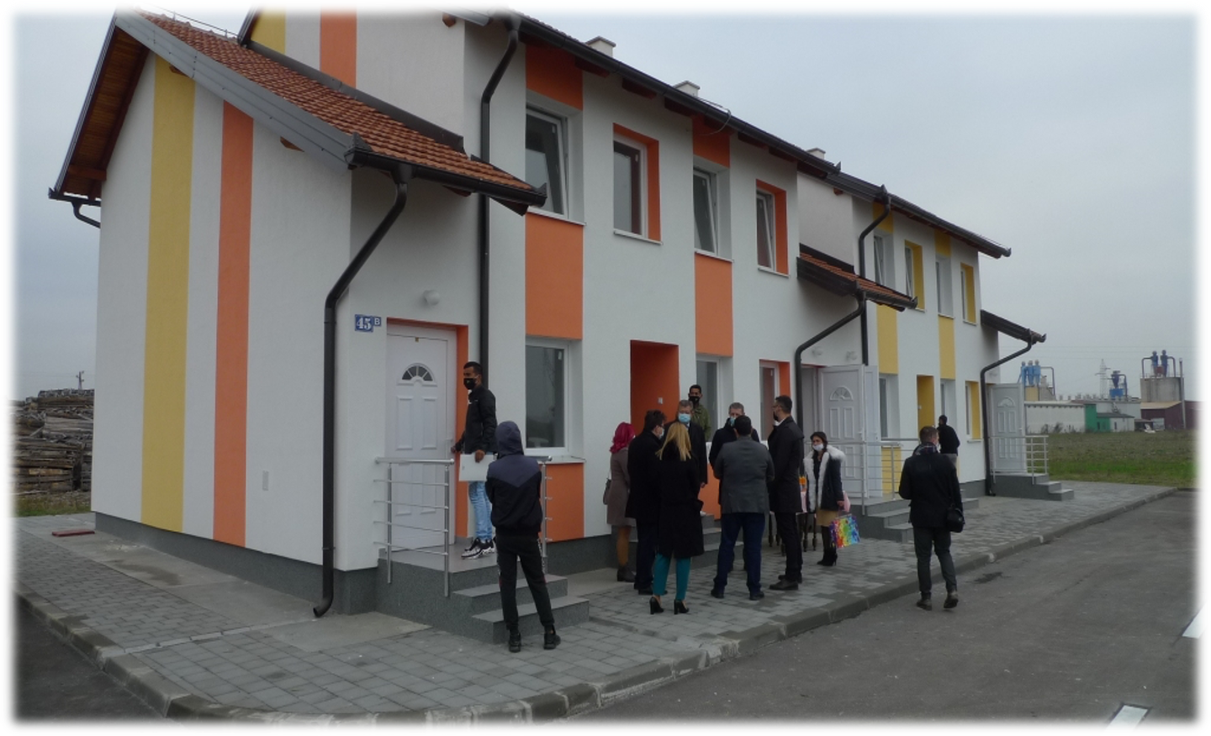
UN-Habitat’s Approach To Housing
Housing as a Human Right

Slide 7
Housing As A Human Right
SGD 11.1: Access for all to adequate, safe and affordable housing and basic services and upgrade slums.
Components of adequate housing
Legal Security of Tenure: Protection against forced eviction, harassment, and arbitrary displacement.
Affordability: Housing costs should not threaten an individual’s ability to pay for other basic needs.
Habitability: Providing adequate space, protection from cold, damp, heat, rain, wind, and structural hazards.
Availability of Services: Access to essential services like clean drinking water, energy for cooking/heating, sanitation, and waste disposal
Accessibility: Housing must be accessible to everyone, particularly vulnerable groups.
Location: Proximity to employment, healthcare, schools, and social services.
Cultural Adequacy: Respecting and enabling the expression of cultural identity
UN-Habitat
7
Notes:
Put stuff in from the postion paper

Slide 8
Housing As An Entry Point To Desegregation
Core Principles:
Housing with secure tenure as a catalyst for inclusion
Socially and culturally integrated communities for social cohesion
Desegregation and safeguards by design

Slide 9
Approaches To Desegregation
Settlement Upgrading
Participatory Inclusive Relocation
Urban Redevelopment
De-Isolation

Slide 10
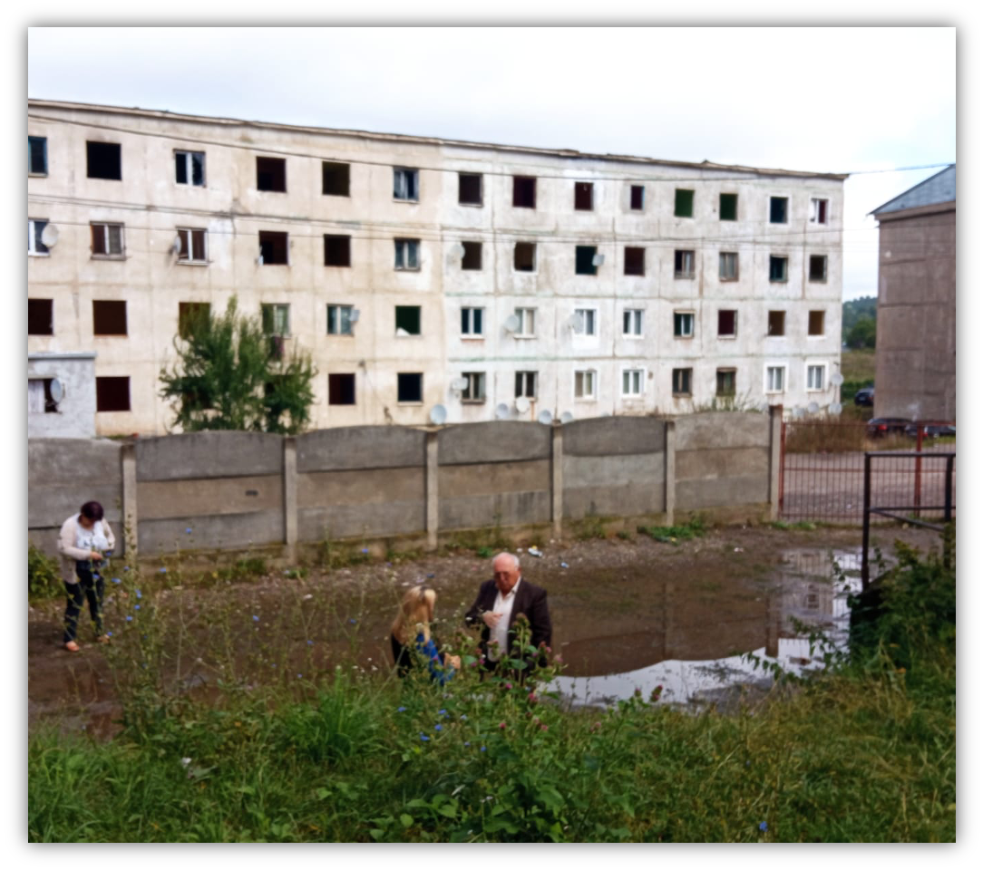
Case Study
Desegregation of Mociur - Reșița, Romania

Slide 11
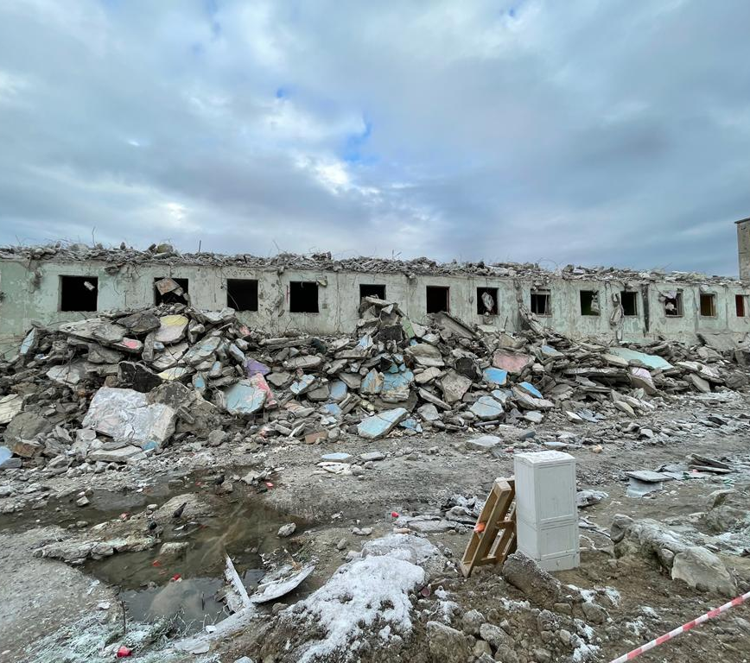
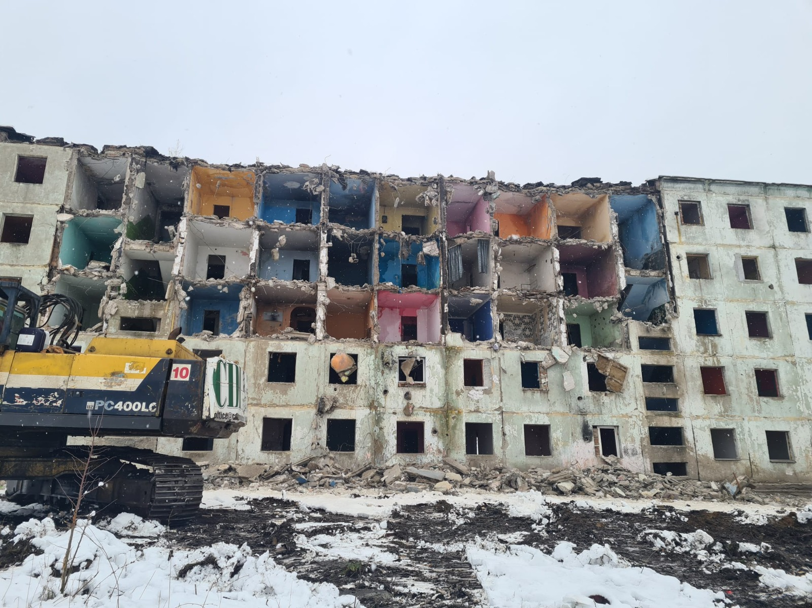
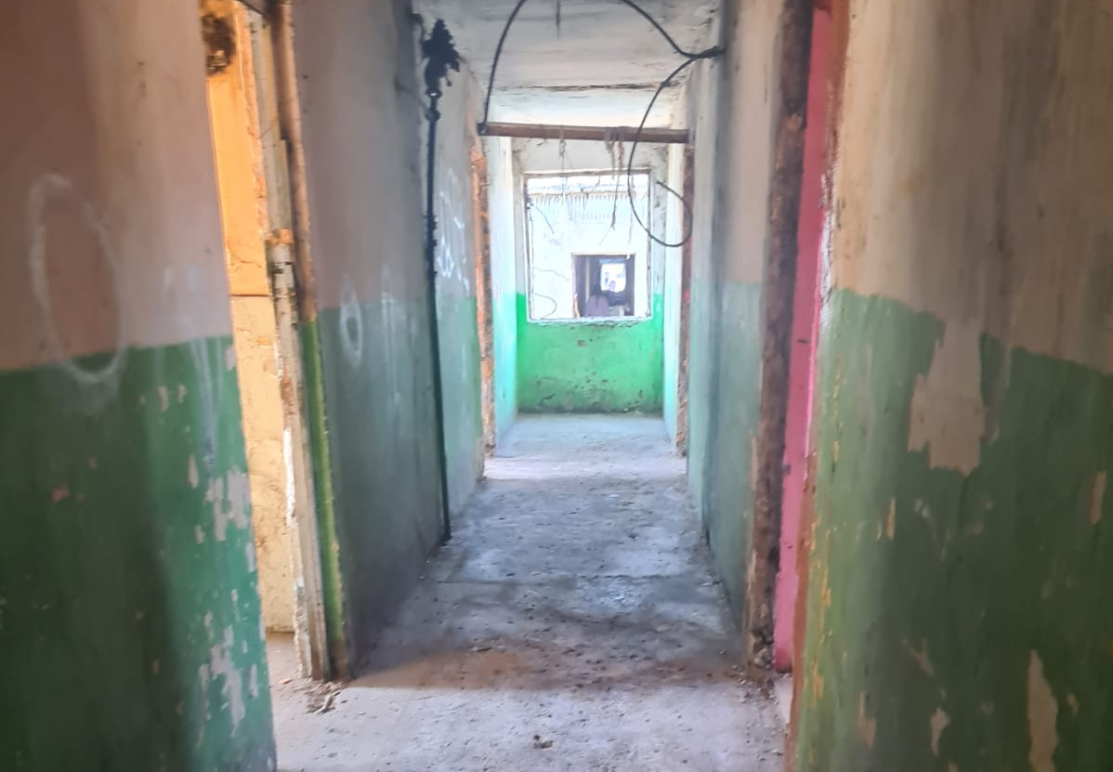
Factsheet: Reșița
Segregated Roma settlement (“Mociur ghetto”) with ~157 families (~580 people)
Poor living conditions: overcrowding, lack of utilities, informal status, social stigma
Limited access to services, high poverty, weak labour market integration

Slide 12
Intervention
Gradual relocation across the city to avoid re-segregation
Mix of solutions: social housing, renovated units, market purchases
Individualised approach respecting family size, income, needs and preferences
Debt resolution mechanisms: work-for-debt and social support
Employment support and creation of social enterprises
Continuous community consultation and participation

Slide 13
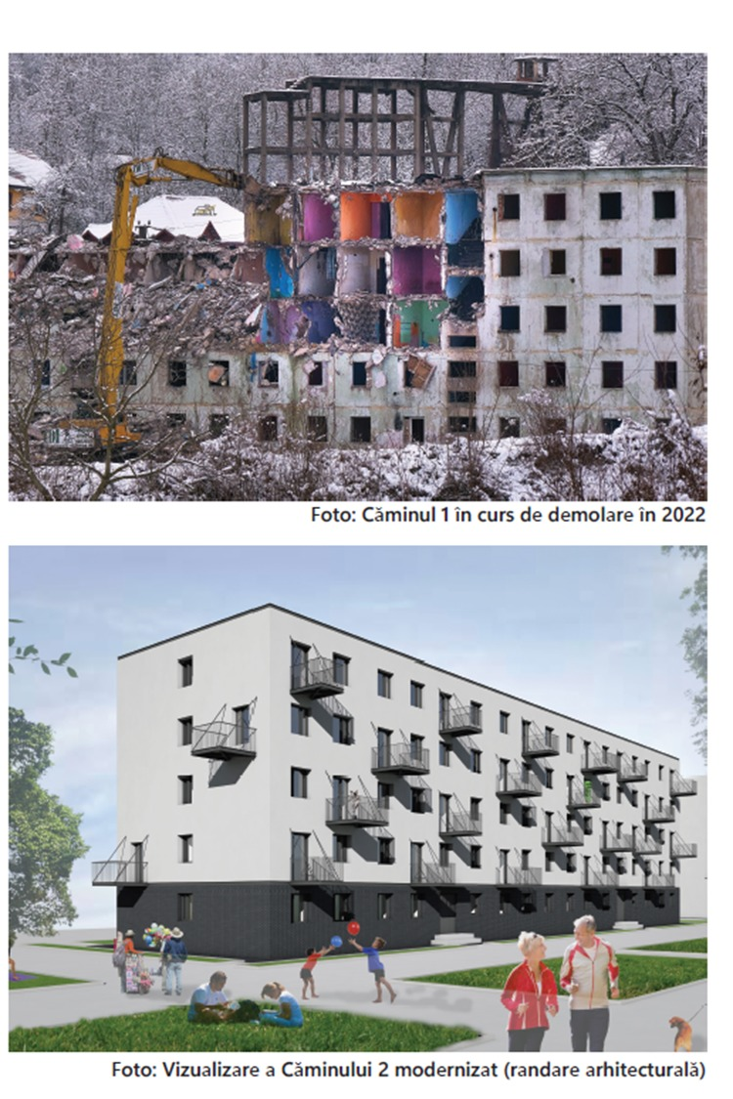
Results
157 families rehoused
Improved living conditions
A former ghetto transformed into a regular neighbourhood
Generally smooth integration, limited conflict
Ongoing monitoring and social support

Slide 14

An Inclusive Settlements Approach
UN-Habitat’s Theory of Change

Slide 15
The Role of Cities
How can cities shape their Roma futures?
Mobilizing stakeholders
Facilitating the planning process
Enabling access to land
Ensuring equitable service delivery
Cities can act through integrated city-level development strategies
15

Slide 16
Core Enablers
Planning
Territorial, city and community level
Critical Enabler:
Political Will
Policy Frameworks and Effective Multi-Level Governance
Create legislation and institutional capacity at all levels
Finance
Diverse financial resources and assets
16

Slide 17
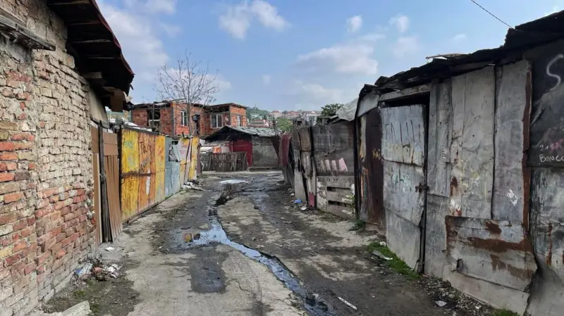
Technical/Financial Instruments
Global tools for Roma Desegregation

Slide 18
Technical/Financial Instruments
Special Planning Zones
Adapt
Minimizes demolition
Social Tenure Domain Model
Community driven
Rapid
Internal Cross Subsidies
Leverage land and private sector investment for affordable housing
Community Land Trusts
Relatively Cheap
Enables long-term affordable housing
Enables tenure security
Cost Effective
UN-Habitat

Slide 19
UN-Habitat’s Role In Enabling Implementation
Policy to Implementation
Urban Development Expertise
Multilevel Governance: National, Regional and Local authorities
Settlements Upgrading Approach

Slide 20
Roma Housing and Inclusive Neighbourhoods Platform

Slide 21
Objectives
Strengthen the ecosystem
Share knowledge and build capacity
Provide Technical Assistance
Unlock Finance
Advance rights-based advocacy

Slide 22
Impact
Effective Enabling Environments
Investment Readiness
Delivery and Scale

Slide 23
Thank you!
www.unhabitat.org

